Slide 1

EPPS 6356-Data Visualization Final Project presentation-Wage Trends by Sectors among China, U.S. and Canada
Instructor: Karl Ho
Present by Yuming Wang

Slide 2
Background
Wages earnings are an important income for people.
Families and employees are expected to have wage increase to raise their living standards” (Congressional Research Service).
Different countries have different wage growth rate.

Slide 3
Research Statement
I am interested in studying how the workers’ wages grow differently in various sectors in last decade in different countries.
Their growth rates appear similarly or have significant differences among different countries.
Specifically, I would like to compare the differences of wages growth rate by sectors in US, Canada, and China.

Slide 4
Data
Collect firsthand data from official website for each country.
Gather these data in Excel, then calculate growth rate for each country.
Import data into R and Github Website.

Slide 5
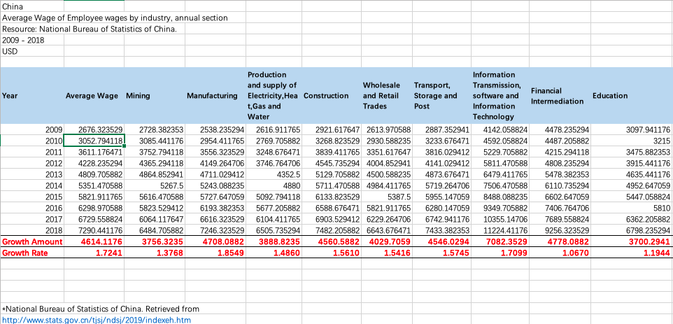
China Wage Data from 2009-2018

Slide 6
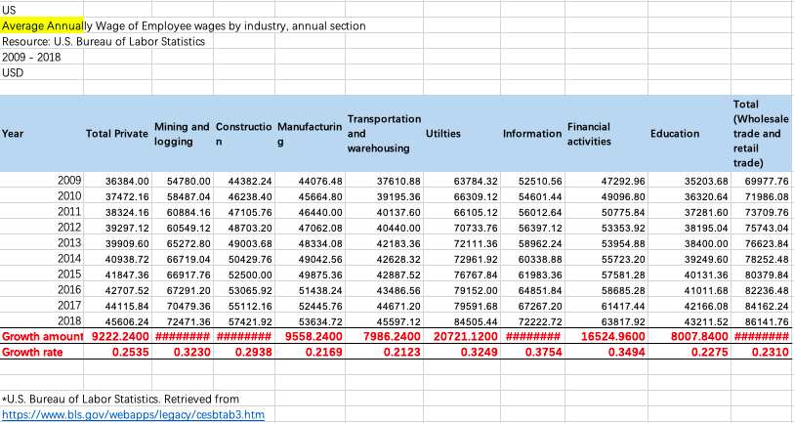
U.S. Wage Data from 2009-2018

Slide 7
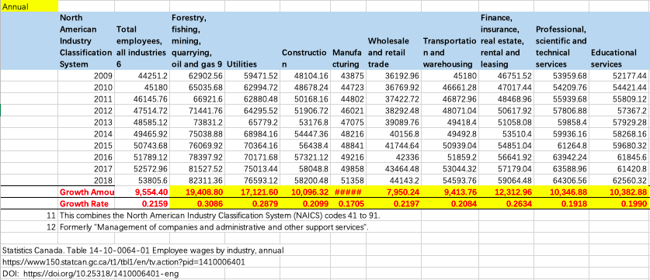
Canada Wage Data from 2009-2018

Slide 8
Methods
Bar Chart-GGplot2
Can directly see the difference of growth rate for each country.
Shiny App
Sort by each Sector, just show what sector you want to see.

Slide 9
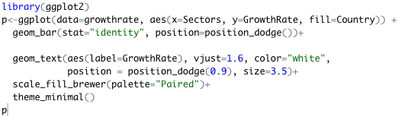
GGplot2 Code

Slide 10
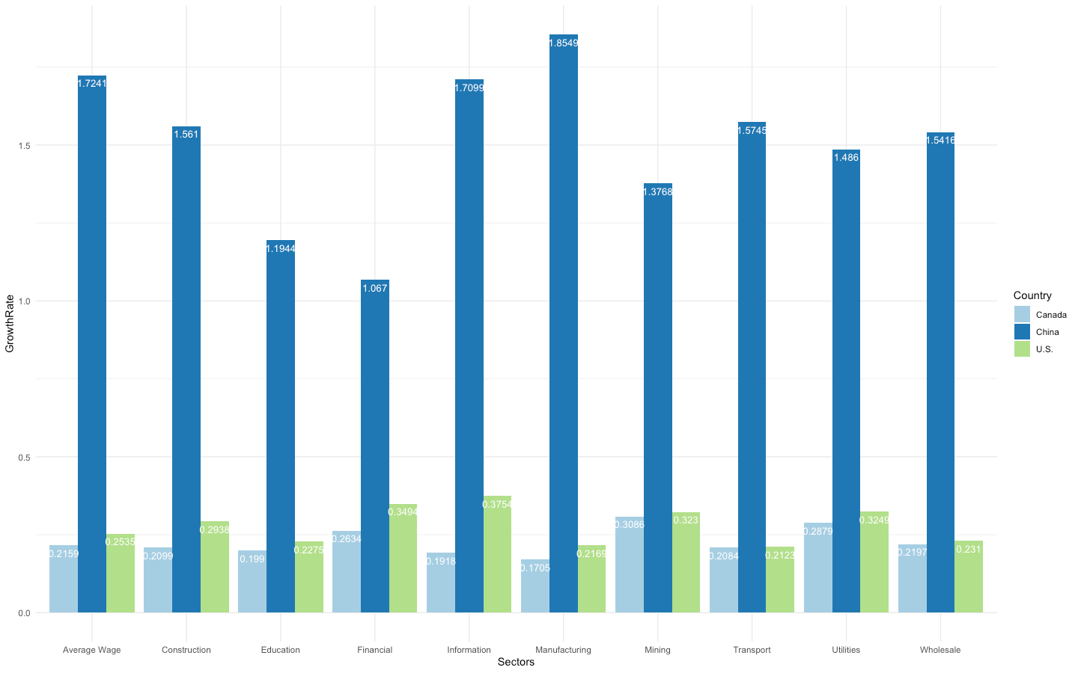
GGplot2 Product

Slide 11

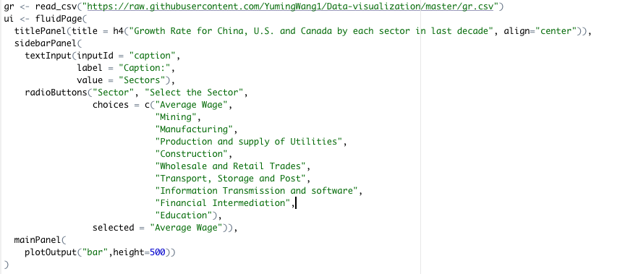
Shiny Code

Slide 12

Shiny Code

Slide 13
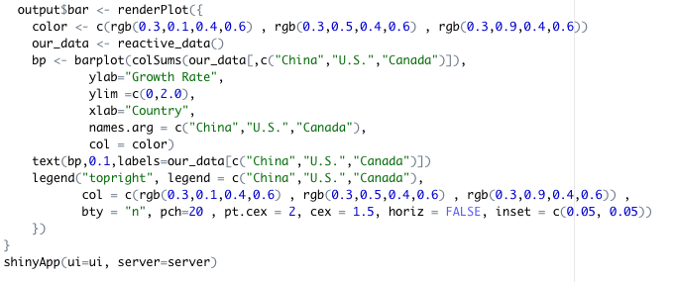
Shiny Code

Slide 14
Shiny Product
Github Page:
https://yumingwang1.github.io/Data-visualization/

Slide 15
Conclusion
China has the highest Wage Growth Rate in the last decade by any Sectors, cause China is a developing country.
There is little difference in wage growth Between Canada and the United States.
Despite the high rate of wage growth rate in China, the amount of wages in China is significantly smaller than in the U.S. and Canada.

Slide 16
References
Congressional Research Service. July 23, 2019. Real Wage Trends, 1979 to 2018. Retrieved from
https://fas.org/sgp/crs/misc/R45090.pdf#:~:text=Other%20factors%20are%20likely%20to%20contribute%20to%20wage,institutions%2C%20workplace%20organization%20and%20practices%2C%20and%20macroeconomic%20trends.
Information Satiation. March 12, 2018. Why Do Wage Rise? Civic and Economic Literacy, Minimum Wage. Retrieved from https://informationstation.org/video/why-do-wages-rise/
National Bureau of Statistics of China. Retrieved from http://www.stats.gov.cn/tjsj/ndsj/2019/indexeh.htm
Statistic Canada. Retrieved from
https://www150.statcan.gc.ca/t1/tbl1/en/tv.action?pid=1410006401&pickMembers%5B0%5D=1.1&pickMembers%5B1%5D=2.3&pickMembers%5B2%5D=3.1&pickMembers%5B3%5D=5.1&pickMembers%5B4%5D=6.1&cubeTimeFrame.startYear=2005&cubeTimeFrame.endYear=2019&referencePeriods=20050101%2C20190101
U.S. Bureau of Labor Statistics. Retrieved from https://www.bls.gov/webapps/legacy/cesbtab3.htm
U.S. Bureau of Labor Statistics. Retrieved from https://www.bls.gov/oes/current/oes_nat.htm#25-0000

Slide 17
Thank you for your time!

